Slide 1

Explore Zomato restaurants dataset in the city of Kolkata

Slide 2
Introduction
Background
Kolkata is the capital of the Indian state of West Bengal. Located on the eastern bank of the Hooghly River, the city is approximately 80 kilometres (50 mi) west of the border with Bangladesh. It is the primary business, commercial, and financial hub of Eastern India and the main port of communication for North-East India, as well as having the third-largest urban economy of India. Kolkata is home to 9,600 millionaires and 4 billionaires with a total wealth of $290 billion. According to the 2011 Indian census, Kolkata is the seventh-most populous city in India, with a population of 4.5 million residents within the city limits, and a population of over 14.1 million residents in the Kolkata Metropolitan Area, making it the third-most populous metropolitan area in India. The Port of Kolkata is India's oldest operating port and its sole major riverine port. Kolkata is known as the "cultural capital of India" for the city's historical and architectural significance.
The official language of Kolkata and the one that is most widely spoken is Bengali. However, English is also spoken as a formal language within businesses and government agencies. Over the last few years, it is continuously grown because of the city’s important role in government and commercial business.
Business Problem
With it’s diverse culture , comes diverse food items. There are many restaurants in Kolkata City, each belonging to different categories like Chinese , Italian , French etc. So as part of this project , we will list and visualize all major parts of Kolkata City .
What is best location in Kolkata City for Chinese Cuisine ? Which areas have large number of Chinese Restaurant Market ? Which all areas have less number of restaurant ? Which is the best place to stay if I prefer Chinese Cuisine ? What places are have best restaurant in Kolkata?

Slide 3
Objectives
Questions that can be asked using the above mentioned datasets
What is best location in Kolkata City for Chinese Cuisine ?
Which areas have large number of Chinese restaurant Market ?
Which all areas have less number of restaurant ?
Which is the best place to stay if I prefer Chinese Cuisine ?
What places are have best restaurant in Kolkata?

Slide 4
Data
For this project we need the following data :
Kolkata Restaurants data that contains list Locality, Restaurant name, Rating along with their latitude and longitude. Data source : Zomato kaggel dataset(https://www.kaggle.com/shrutimehta/zomato-restaurants-data). Description : This data set contains the required information. And we will use this data set to explore various locality of Kolkata city. Nearby places in each locality of Kolkata city. Data source : Fousquare API (https://developer.foursquare.com/)
Description : By using this api we will get all the venues in each neighborhood.

Slide 5
Approach
The Methodology section will describe the main components of our analysis and predication system. The Methodology section comprises four stages:
Collect Inspection Data
Explore and Understand Data
Data preparation and preprocessing
Modeling
Approach
Collect the Kolkata city data from Zomato kaggel dataset(https://www.kaggle.com/shrutimehta/zomato-restaurants-data). Using FourSquare API we will find all venues for each neighborhood. Filter out all venues that are nearby by locality. Using aggregative rating for each restaurant to find the best places. Visualize the Ranking of neighborhoods using folium library(python)

Slide 6
Results

Slide 7
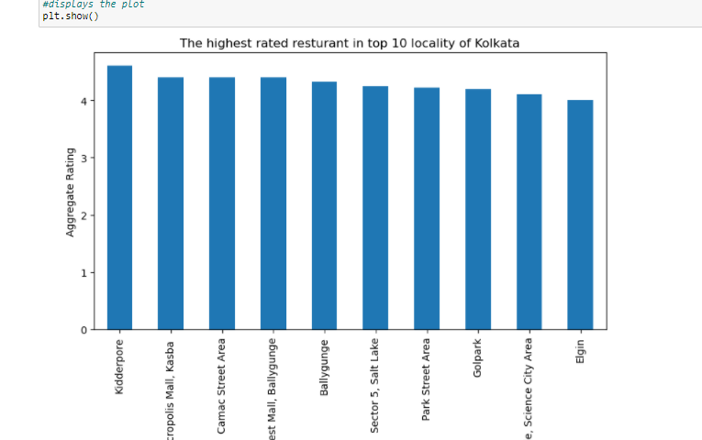

Slide 8
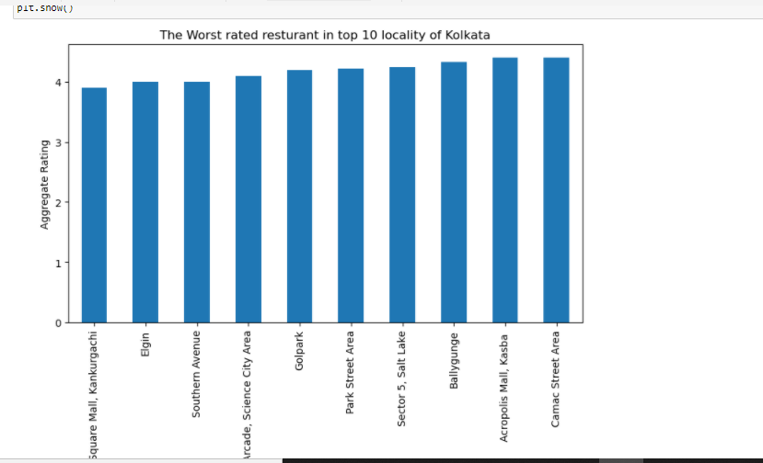

Slide 9
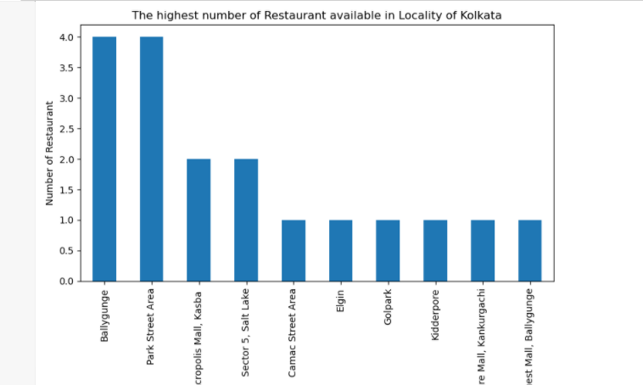

Slide 10
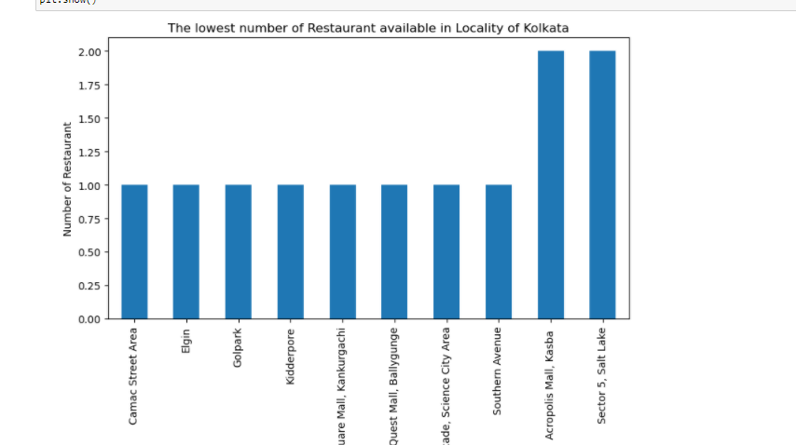

Slide 11
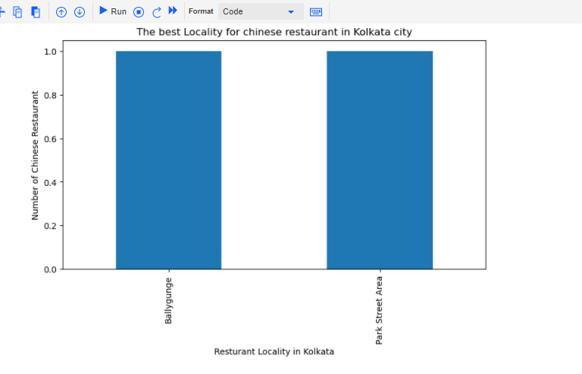

Slide 12
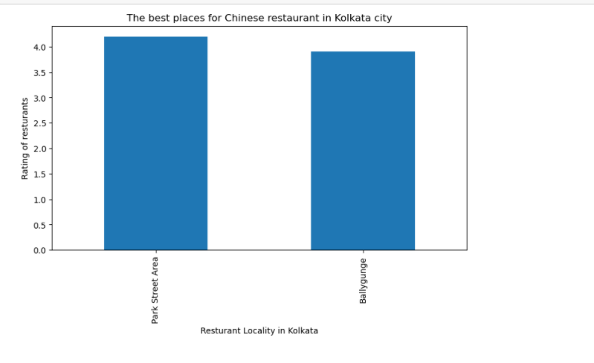

Slide 14
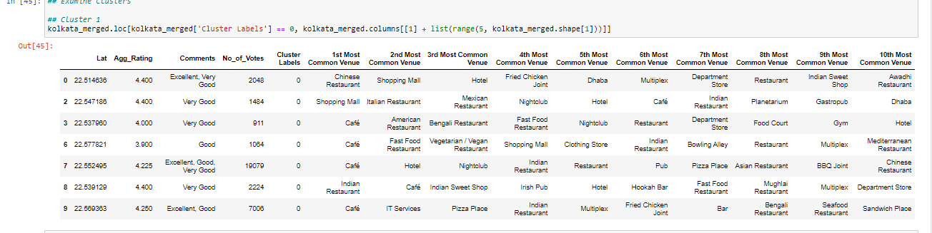
Cluster 1:
It has multiple options as recommended choices.

Slide 15
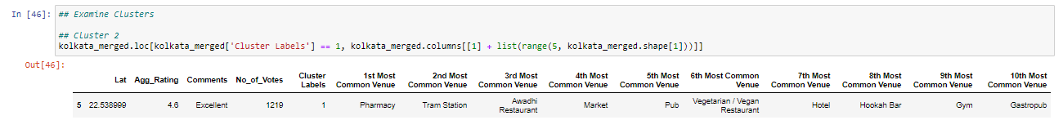
Cluster 2:
It is recommended for the Pharmacy

Slide 16
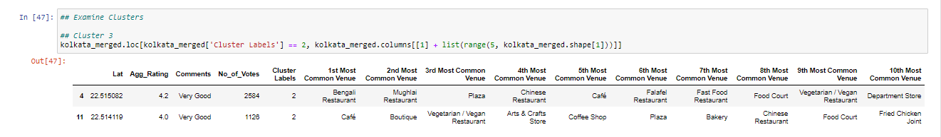
Cluster 3:
It seems like Café, Bengali Restaurant are the popular ones

Slide 17
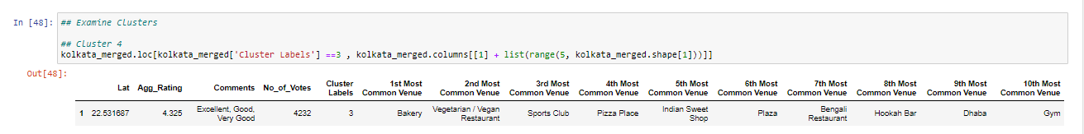
Cluster 4:
It’s most recommended for Bakery

Slide 18
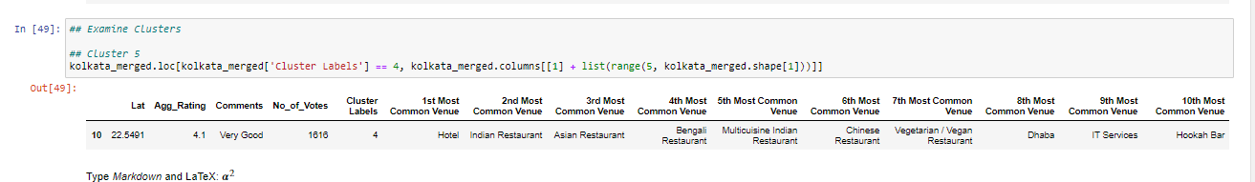
Cluster 5:
Hotel, Restaurants are the most recommended venues

Slide 19
Conclusion
Ballygaunge and Park Street Area are hosting some of the best neighborhoods for Chinese cuisine.
Park Street Area and Ballygaunge have the best Chinese Restaurant.
Park Street Area and Ballygaunge & Acropolis Mall are the best places for edible person.
Kidderpore, Acropolis Mall, Camac Street, Quest Mall have best rated restaurants in Kolkata.

